Slide 1
Developing a sensing area visualisation tool for laparoscopic drop-in gamma prob
Supervisor: Prof. Daniel Elson
Group members:
Yiyang Liu
Yiping Li
Wenkang Li
Muhammad Oktavian

Slide 2
2022/10/24 (2pm — 5pm) Monday
Meeting
Installed SDK for Intel realsense camera D435i
Tested the code to get the image from camera in python
2022/10/25 (2pm — 5pm) Tuesday
Read opencv online resources and tried blob detection
Implemented Aruco Marker detection algorithm
Developed github code management standard
2022/10/27 (10am — 1pm) Thursday
Modified the inception report according to suggestions from professor and TAS
Tested Aruco Marker algorithms
Implemented webcam camera calibration and modified to Realsense camera calibration
2022/10/28 (10am — 1pm) Friday
Try the 3D reconstruction of RGB-D camera for D435i
Check the filter algorism for sample image we found
Check and upload the inception report

Slide 3
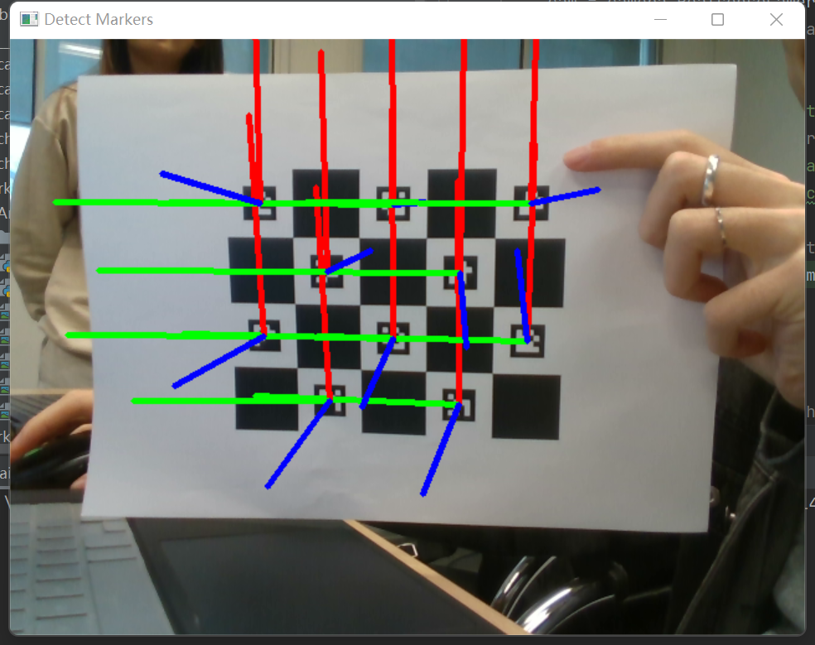
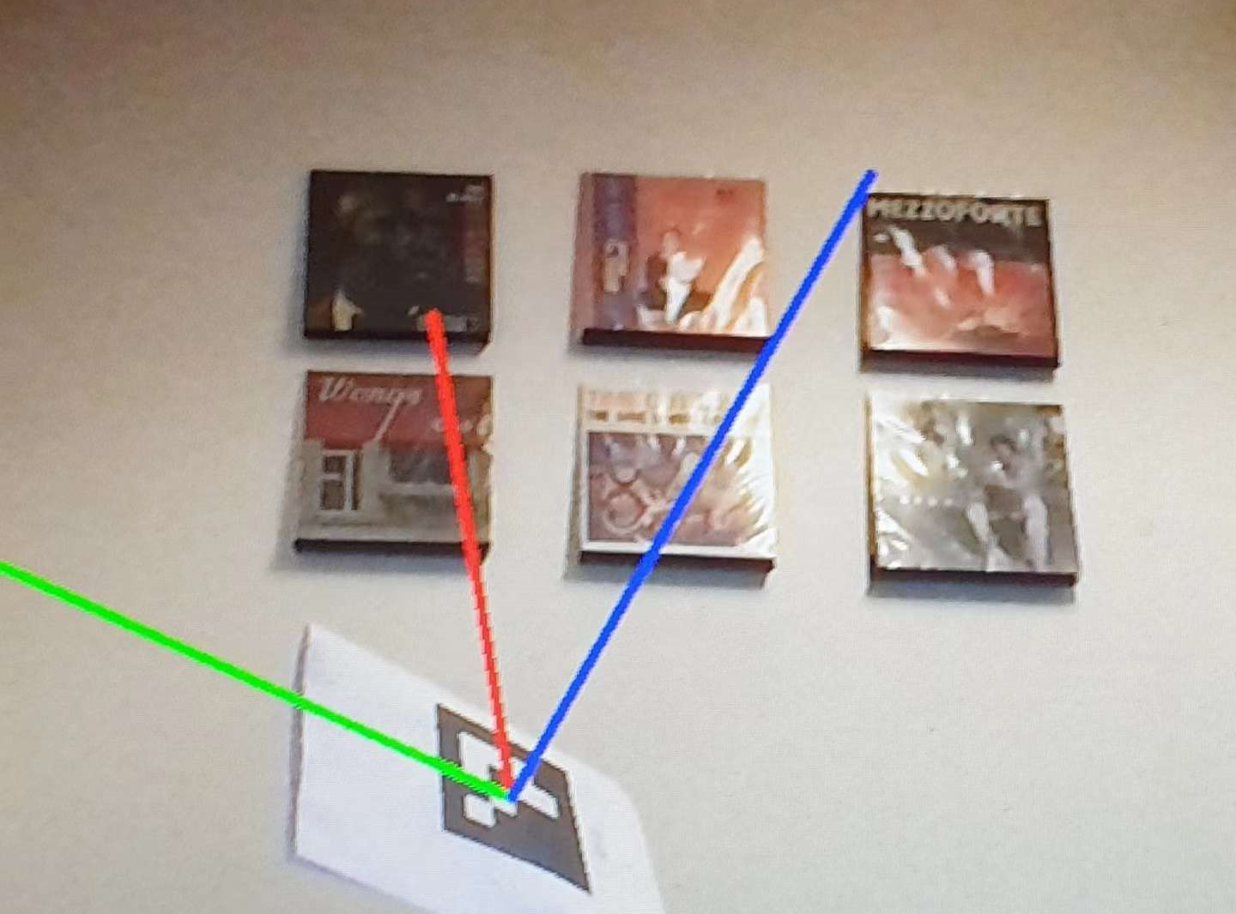
Aruco Marker detection on Realsense camera

Slide 4
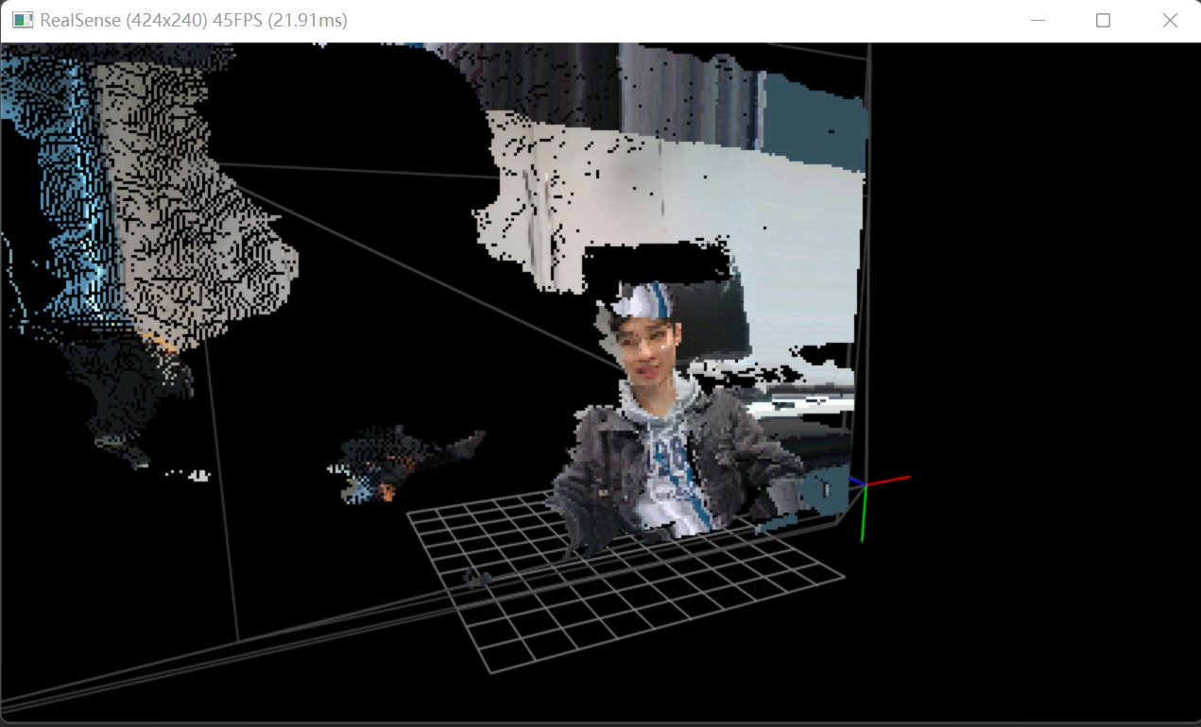
3D reconstruction on Realsense camera

Slide 5
Plan for this week
1. Print and test Aruco marker on the probe
2. If needed design a shell for probe
3. If Aruco marker doesn’t work well on cruve surface or the size of marker if too small for marker to be detected, try other type of markers and algorithms.

